Slide 1
Banking Data Analysis in SQL
SQL Queries for Comprehensive Insights
Presented by: Pranay Halder

Slide 2
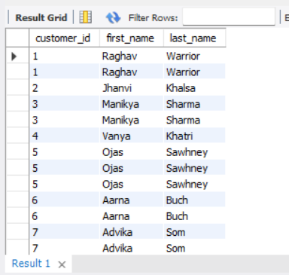
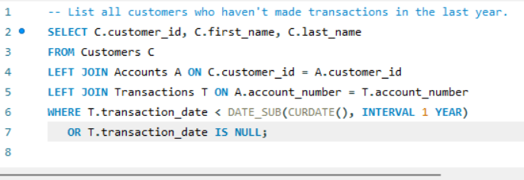
1: Write a query to list all customers who haven't made any transactions in the last year. How can we make them active again? Provide appropriate region.
Query Purpose : Identifies inactive customers (no transactions in the last year) using a LEFT JOIN to find customers with no recent transaction records.
This query helps find inactive customers. To reactivate them, businesses can use targeted marketing, personalized offers, and regional engagement strategies

Slide 3
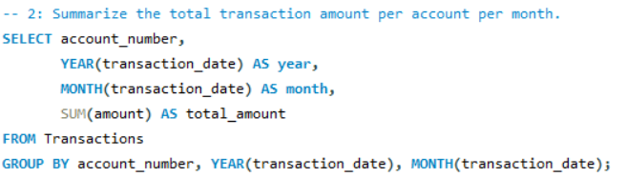
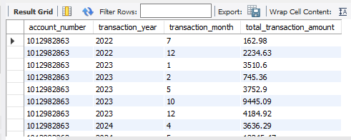
2: Summarize the total transaction amount per account per month.
Query Purpose : Summarizes the total transaction amount for each account, grouped by month and year.
Breakdown:
Account ID: Identifies which account the transactions belong to.
Year and Month: Aggregates transactions on a monthly basis.
SUM: Calculates the total transaction amount for each account per month.
Output: The result includes total transaction amount per account for each month, ordered by account and month.

Slide 4
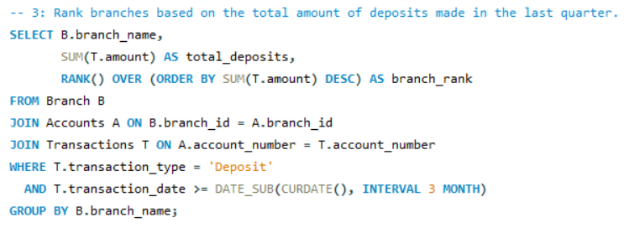
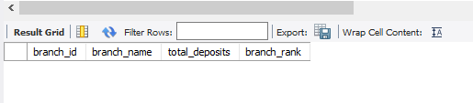
3: Rank branches based on the total amount of deposits made in the last quarter.
Query Purpose:
Ranks branches based on the total amount of deposits made in the last quarter.
Breakdown:
Branch Name: Identifies the branch.
SUM(transaction_amount): Calculates the total deposit amount per branch.
RANK(): Assigns a rank to each branch based on the total deposit amount in descending order.
Output:
Ranked list of branches with their total deposit amounts in descending order.

Slide 5
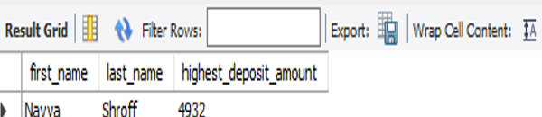
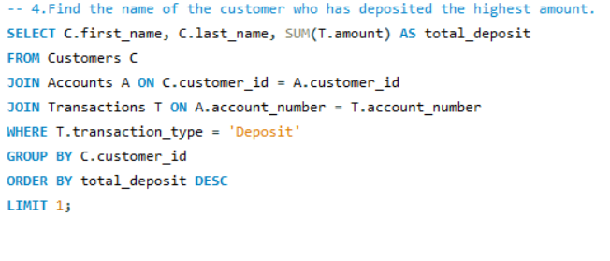
4: Find the name of the customer who has deposited the highest amount.
Query Purpose : Finds the customer who has made the highest total deposit.
Breakdown:
Customer Name: Identifies the customer.
SUM(transaction_amount): Calculates the total deposit
amount for each customer.
WHERE clause: Filters for deposit transactions only.
ORDER BY: Sorts customers by total deposit amount in descending order.
LIMIT 1: Returns only the top customer.
Output: The name of the customer and their total deposit amount.

Slide 6
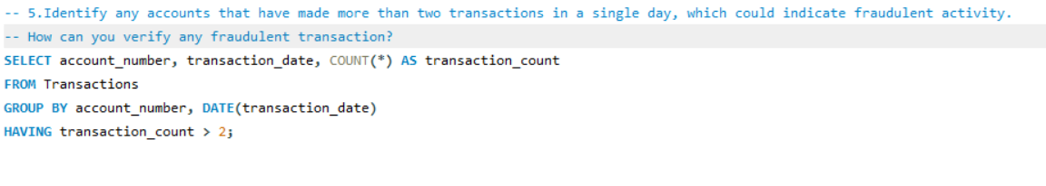
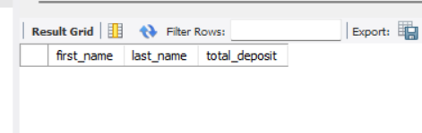
5: Identify any accounts that have made more than two transactions in a single day, which could indicate fraudulent activity. How can you verify any fraudulent transaction?
Query Purpose : Identifies accounts that have made more than two transactions in a single day, which could indicate potential fraudulent activity.
How to Verify Fraudulent Transactions:
Pattern Analysis: Analyze the transaction amounts, frequency, and locations to identify abnormal patterns.
Transaction Details: Look at transaction types (e.g., withdrawals, transfers) and geographical location to detect inconsistencies.
Customer Verification: Contact the customer to confirm if they authorized the transactions.
Risk Scoring: Use a fraud detection model to assign a risk score to the account and transactions based on historical behavior.
Alerts and Monitoring: Set up real-time alerts for suspicious activity.

Slide 7
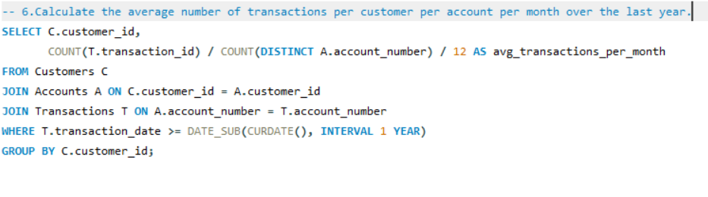
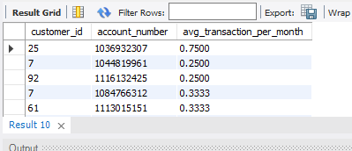
6: Calculate the average number of transactions per customer per account per month over the last year.
Query Purpose: Calculates the average number of transactions each customer makes per account per month over the last year.
Breakdown:
Customer ID and Account ID: Identifies the customer and the account for transaction counting.
COUNT(t.transaction_id): Counts the number of transactions made by the customer on a specific account.
/ 12.0: Divides the transaction count by 12 to calculate the average transactions per month (for the past 12 months).
WHERE Clause: Filters transactions from the last year.
GROUP BY: Groups by both customer and account to calculate per account performance.
Output: Average transactions per customer per account for each month.

Slide 8
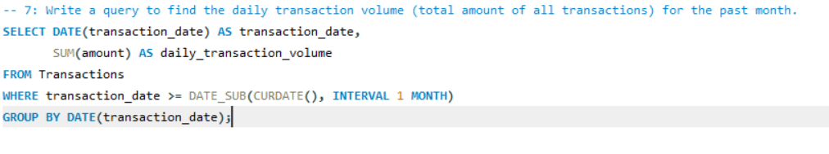

7: Write a query to find the daily transaction volume (total amount of all transactions) for the past month.
Query Purpose : Finds the total transaction volume (sum of all transaction amounts) for each day over the last month.
Breakdown:
transaction_date: Groups the transactions by date.
SUM(t.transaction_amount): Calculates the total transaction amount for each day.
WHERE clause: Filters transactions from the last month.
GROUP BY: Groups the results by transaction date.
Output:
Total transaction volume for each day in the last month

Slide 9
8: Calculate the total transaction amount performed by each age group in the past year. (Age groups: 0-17, 18-30, 31-60, 60+)
Query Purpose:
Calculates the total transaction amount for each age group in the past year.
Age Group Categorization:
0-17: Customers aged between 0 and 17.
18-30: Customers aged between 18 and 30.
31-60: Customers aged between 31 and 60.
60+: Customers aged 60 and above.
Key Functions Used:
CASE statement: Categorizes customers into age groups based on their birthdate.
FLOOR(DATEDIFF(...)): Calculates the customer's age by determining the difference between their birthdate and the current date.
SUM(t.transaction_amount): Calculates the total transaction amount for each age group.
Data Filtering:
WHERE t.transaction_date >= CURRENT_DATE - INTERVAL 1 YEAR:
Ensures only transactions from the past year are considered.
Output:
Total transaction amount for each age group over the past year.

Slide 10
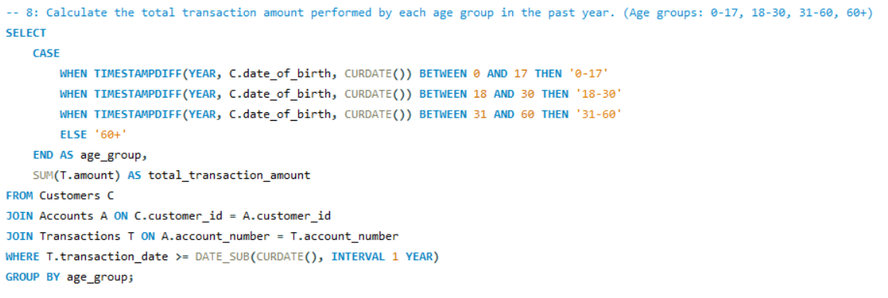
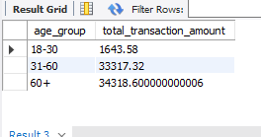

Slide 11
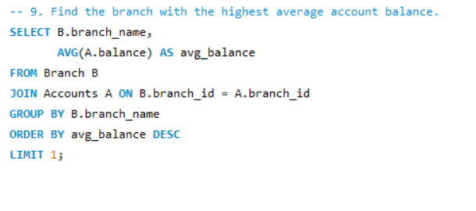
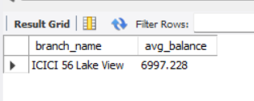
9: Find the branch with the highest average account balance.
Query Purpose:
Identifies the branch with the highest average account balance.
Breakdown:
AVG(a.balance): Calculates the average account balance for each branch.
JOIN: Combines the accounts table with the branches table to link accounts to their respective branches
GROUP BY b.branch_name: Groups the results by branch to compute the average balance per branch.
Ordering:
ORDER BY avg_account_balance DESC: Sorts branches in descending order based on their average account balance.
LIMIT 1: Returns only the top branch with the highest average account balance.
Output:
The branch name and its average account balance

Slide 12
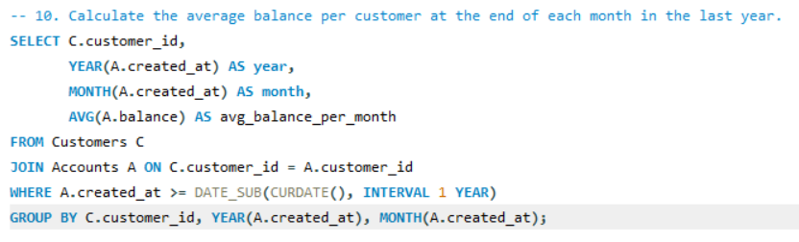
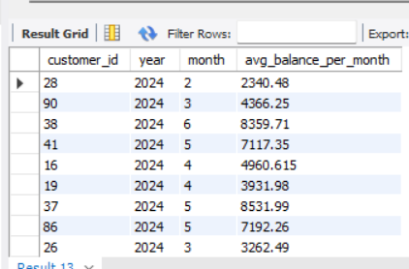
10: Calculate the average balance per customer at the end of each month in the last year.
Query Purpose:
Calculates the average balance for each customer at the end of each month in the last year.
Breakdown:
LAST_DAY(t.transaction_date): Finds the last day of the month for each transaction.
DATE_FORMAT(..., '%Y-%m'): Formats the last day as YYYY-MM to represent each month.
AVG(a.balance): Computes the average balance for each customer at the end of each month.
Filtering:
WHERE t.transaction_date >= CURRENT_DATE - INTERVAL 1 YEAR: Filters transactions to only include the last year.
Grouping and Sorting:GROUP BY c.customer_id, month_end: Groups by customer and month to calculate averages per customer per month.
ORDER BY c.customer_id, month_end: Orders the result by customer ID and month for better readability.
Output:
Customer ID, Month (end of month), and average balance for each customer at the end of the month,

Slide 13
THANK YOU !

